Slide 1
Announcements
Project 2. Some tips:
Lists, Sets, Maps. Use them (not necessarily all of them).
If you find yourself having nested generic declarations, e.g. Map<Map<... or List<List<..., this is fine, but consider creating a new class that has an instance variable that hides the ugly truth.
E.g. instead of having x.get(5).get(3) for a list of lists, you can write your own class that has a get(5, 3) method.
Break things down into smaller pieces. Layers of abstraction are absolutely vital.
Trying to do everything at the lowest layer (TETile[][]) will probably be very unpleasant.
Example: A bad idea I briefly had was a single method with tricky nested for loops that tried to draw L-shaped hallways.
Recursion: Very natural for world generation (but not necessary).

Slide 2
Announcements
Project 2.
If you had any sort of partner matching mishap (e.g. partner never replied) and you want a partner, please fill out the partner matching form again ASAP.

Slide 3
CS61B: 2018
Lecture 15: Packages, Javadocs, Access Control, Objects
Packages and JAR Files
Javadocs
Access Control
Object Methods: Equals and toString()

Slide 4
Packages and JAR Files

Slide 5
Packages
To address the fact that classes might share names:
A package is a namespace that organizes classes and interfaces.
Naming convention: Package name starts with website address (backwards).
We won’t follow this rule. Our code isn’t intended for distribution.
If used from the outside, use entire canonical name.
package ug.joshh.animal;
public class Dog {
private String name;
private String breed;
private double size;
ug.joshh.animal.Dog d =
new ug.joshh.animal.Dog(...);
org.junit.Assert.assertEquals(5, 5);
If used from another class in same package (e.g. ug.joshh.animal.DogLauncher), can just use simple name.
Dog.java

Slide 6
Creating a Package
Two steps:
At the top of every file in the package, put the package name.
Make sure that the file is stored in a folder with the appropriate folder name. For a package with name ug.joshh.animal, use folder ug/joshh/animal.
If used from the outside, use entire canonical name.
package ug.joshh.animal;
public class Dog {
private String name;
private String breed;
private double size;
ug.joshh.animal.Dog d =
new ug.joshh.animal.Dog(...);
org.junit.Assert.assertEquals(5, 5);
If used from another class in same package (e.g. ug.joshh.animal.DogLauncher), can just use simple name.
Dog.java

Slide 7
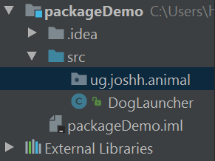
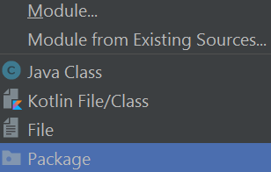
Creating a Package in IntelliJ
In Intellij:
File -> New Package
Choose a package name, e.g. “ug.joshh.animal” and it will appear in the list of files for your project.
In the example to the right, the project has the empty package ug.joshh.animal, and a source file called DogLauncher that is not part of the ug.joshh.animal package.

Slide 8
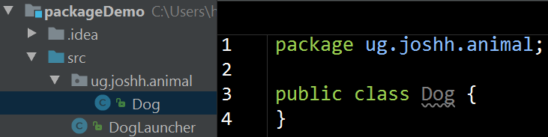
Adding a Java File to a Package in Intellij
Right-click the package name, and select New → Java Class.
This will create a file called Dog.java that is under the subheading of “ug.joshh.animal”, and will automatically fill in the first line of the file with the package declaration.

Slide 9
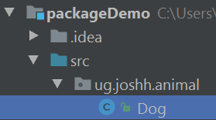

What’s Happening Under the Hood
There are two steps to creating a package:
At the top of every file in the package, put the package name.
Make sure that the file is stored in a folder with the appropriate folder name. For a package with name ug.joshh.animal, use folder ug/joshh/animal.
Under the hood the things we did in IntelliJ did exactly this!
To see this in action, right click the Dog class in the top left, and then click “Show in Explorer”.
You’ll see that the Dog.java file is in a folder called
…./src/ug/joshh/animal

Slide 10
Using Packages
As we saw in a previous lecture, to use a class from package A in a class from package B, we use the canonical name.
For example, in the DogLauncher class, which is not part of the ug.joshh.animal package, can create a Dog using the syntax below.
By using an import statement, we can use the simple name instead.
ug.joshh.animal.Dog d =
new ug.joshh.animal.Dog(...);
import ug.joshh.animal.Dog;
...
Dog d = new Dog(...);

Slide 11
The Default Package
Any Java class without a package name at the top are part of the “default” package. As Stack Overflow user Dan Dyer wisely puts it: “You should avoid using the default package except for very small example programs.”
In other words, from now on, when writing real programs, your Java files should always start with a package declaration.
Idea: Ensure that we never have two classes with the same name.
Note: You cannot import code from the default package!
No way that anything in the ug.joshh.animal package could ever use DogLauncher (which is in the default package).

Slide 12
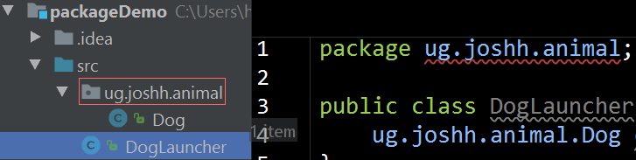
Moving a Class into a Package
From this point on in 61B, all code for each HW and project will be part of its own package. You’ll never need to define multiple packages at once in 61B.
If you realize you should have made something part of a package, simply:
Add “package [packagename]” to the top of the file. IntelliJ will complain that the file is in the wrong folder and won’t compile until you...
Move the .java file into the appropriate folder.
Protip, you can drag the file in the top left Project viewer.

Slide 13
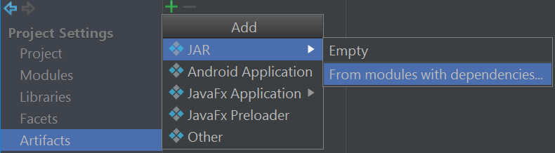
JAR Files
Suppose you’ve written a program that you want to share.
Sharing dozens of .class files in special directories is annoying.
Can instead share a single .jar file that contains all of your .class files.
JAR files are really just zip files, but with some extra info added.
To create a JAR file: 1. Go to File → Project Structure, and select the option below:

Slide 14
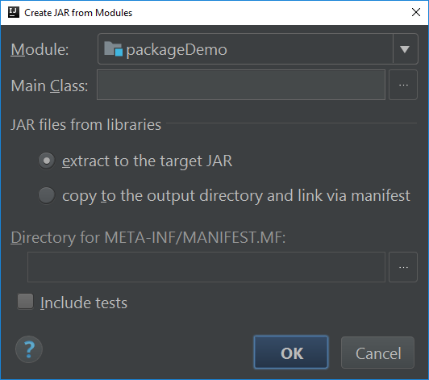
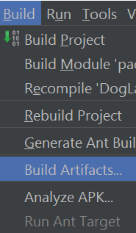
JAR Files
Step 2: Click OK a couple of times.

Slide 15
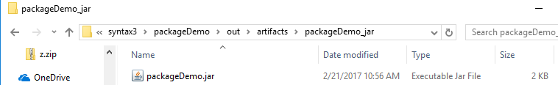
JAR Files
Step 3: Click Build -> Build Artifacts.
The jar file will be generated in a folder called “Artifacts”.
Step 4: Give to other Java programmers, who can use your jar by importing it into IntelliJ (or otherwise).
Also possible to run a “Main class” of a package from command line. Not discussed in lecture. See Google for more.

Slide 16
Note on JAR Files
JAR files are just zip files.
They do not keep your code safe!
Easy to unzip and transform back into .Java files.
Important: Do not share .jar files of your projects with other students.

Slide 17
Build Systems
To avoid the need to import a bunch of libraries, put files into the appropriate place, and so forth, there exist a number of “Build Systems”.
Popular build systems include:
Ant
Maven
Gradle (ascendant)
Very useful for large teams and large projects. Advantages are fairly minimal in 61B. We’ll use Maven in Project 3.

Slide 18
Access Control

Slide 19
Access Control with Inheritance and Packages
How do public and private behave with packages and subclasses?
Can a subclass access a private member of its superclass?
Could a SpecialArrayMap access the private KeyIterator class?
Can a class X in a package access a private member of its package buddy Y?
Could a GuitarString access the private variables of an ArrayRingBuffer?
Modifier | Class | Package | Subclass | World
public | Y | Y | Y | Y
private | Y | N | N | N
No in both cases:
Only code from the a given class can access private members.

Slide 20
Access Control with Inheritance and Packages
Modifier | Class | Package | Subclass | World
public | Y | Y | Y | Y
private | Y | N | N | N
package syntax3.map;
public class ArrayMap ... {
private int size; ...
package syntax3.map;
public class MyonicArrayMap extends ArrayMap {
public MyonicArrayMap(int s) {
size = s; ...
$ javac *.java
MyonicArrayMap:5: error: size has private access in ArrayMap
size = s;
^

Slide 21
The Protected Keyword
Protected modifier allows package-buddies and subclasses to use a class member (i.e. field/method/constructor).
Outsiders cannot access.
Modifier | Class | Package | Subclass | World
public | Y | Y | Y | Y
protected | Y | Y | Y | N
private | Y | N | N | N
package syntax3.map;
public class ArrayMap ... {
protected int size; ...
package syntax3.map;
public class MyonicArrayMap extends ArrayMap {
public MyonicArrayMap(int s) {
size = s; ...

Slide 22
Access Control with Inheritance and Packages
Using no modifier allows classes from the same package, but not subclasses, to access the member.
Often referred to as “package private”.
Modifier | Class | Package | Subclass | World
public | Y | Y | Y | Y
protected | Y | Y | Y | N
 | Y | Y | N | N
private | Y | N | N | N

Slide 23
Access Control with Inheritance and Packages
Modifier | Class | Package | Subclass | World
public | Y | Y | Y | Y
protected | Y | Y | Y | N
 | Y | Y | N | N
private | Y | N | N | N
package syntax3.map;
public class ArrayMap ... {
int size; ...
package syntax3.map;
public class MyonicArrayMap extends ArrayMap {
public MyonicArrayMap(int s) {
size = s; ...
Q: Will this work?
package syntax3.map;
public class MapHelper {
public static void printSize(ArrayMap am) {
System.out.println(am.size);
Yes!
Q: Will this work?
Yes!

Slide 24
Random Question Out of Nowhere: shoutkey.com/TBA
Which looks best? A/B/C? Answer here: http://shoutkey.com/out
String actual = MapHelper.maxKey(m);
String expected = "house";
assertEquals(expected, actual);
A
String actual = MapHelper.maxKey(m);
String expected = "house";
assertEquals(expected, actual);
B
String actual = MapHelper.maxKey(m);
String expected = "house";
assertEquals(expected, actual);
C

Slide 25
Access Control with Inheritance and Packages: yellkey.com/any
Modifier | Class | Package | Subclass | World
public | Y | Y | Y | Y
protected | Y | Y | Y | N
 | Y | Y | N | N
private | Y | N | N | N
package syntax3.map;
public class ArrayMap ... {
int size; ...
package illuminati;
public class ChattyMap extends ArrayMap {
public void printSize() {
System.out.println(size); ...
Q: Will this work?

Slide 26
Access Control with Inheritance and Packages
Modifier | Class | Package | Subclass | World
public | Y | Y | Y | Y
protected | Y | Y | Y | N
 | Y | Y | N | N
private | Y | N | N | N
$ javac ChattyMap.java ../map3/syntax3/*.java
ChattyMap:4: error: size is not public in ArrayMap; cannot be accessed from outside package
System.out.println(size); ...
^
package syntax3.map;
public class ArrayMap ... {
int size; ...
package illuminati;
public class ChattyMap extends ArrayMap {
public void printSize() {
System.out.println(size); ...
Q: Will this work?
No!

Slide 27
A Point to Ponder
Why was Java designed to have the top table instead of the bottom one (or something similar)?
In other words, why are package members considered more “secret” than subclass members?
Modifier | Class | Package | Subclass | World
public | Y | Y | Y | Y
protected | Y | Y | Y | N
 | Y | Y | N | N
private | Y | N | N | N
Modifier | Class | Package | Subclass | World
 | Y | Y | Y | Y
 | Y | Y | Y | N
 | Y | N | Y | N
 | Y | N | N | N

Slide 28
A Point to Ponder
Why was Java designed to have the top table instead of the bottom one (or something similar)?
Extending classes you didn’t write is common.
Packages are typically modified only by a specific team of humans.
Modifier | Class | Package | Subclass | World
public | Y | Y | Y | Y
protected | Y | Y | Y | N
 | Y | Y | N | N
private | Y | N | N | N
Modifier | Class | Package | Subclass | World
 | Y | Y | Y | Y
 | Y | Y | Y | N
 | Y | N | Y | N
 | Y | N | N | N

Slide 29
The Default Package
What about code that doesn’t have a package declaration?
As mentioned earlier, code without a package label is part of an unnamed package, a.k.a. the “default package”.
Don’t have any access modifiers or package names?
Everything is package-private.
Everything is part of the same (unnamed) default package.
same (unnamed) default package
public class CeccoBeppe {
void leap() {
System.out.println("leapt");
public class Tane {
public static void main(String[] args) {
CeccoBeppe cb = new CeccoBeppe();
cb.leap();
package private

Slide 30
Access Is Based Only on Static Types
package universe;
public interface BlackHole {
void add(Object x);
}
Try to predict if the compiler will allow each line of Client.
Not part of the universe package!
add might look package private, actually public
import static CreationUtils.hirsute;
class Client {
void demoAccess() {
BlackHole b = hirsute();
b.add("horse");
b.get(0);
HasHair hb = (HasHair) b;
}
}
package universe;
public class CreationUtils {
public static BlackHole hirsute() {
return new HasHair();
}
}
Yes
Yes
No
No
package universe;
class HasHair implements BlackHole {
Object[] items;
public void add(Object o) { ... }
public Object get(int k) { ... }
}
Can’t refer to a HasHair blackhole from outside the package. However, can still called methods on objects of dynamic type HasHair (if we have a reference with allowable static type).

Slide 31
A More Practical Example of Static Type Access Control
public class ArrayMap<K, V> implements Iterable<K> {
private class KeyIterator implements Iterator<K> {
private int wizardPosition;
public KeyIterator () {
wizardPosition = 0;
}
...
public Iterator<K> iterator() { return new KeyIterator(); }
Can never get a MapWizard (it’s private), but the following works just fine:
ArrayMap<Gorgon, Pug> am = new ArrayMap<Gorgon, Pug>();
Iterator<Gorgon> it = am.iterator();
it.hasNext();
An earlier version of this slide erroneously said am.hasNext()

Slide 32
Access Control at the Top Level
So far we’ve discussed how to control access to members.
Also possible to control access at the top level (i.e. an entire interface or class).
Two levels:
public
no modifier: package-private
Determines who can see the existence of the class.
Choices: Entire world vs. just members of same package.
Cyberbrain visible only to members of robot package.
package robot;
class Cyberbrain {
...
}
No such thing as a sub-package, BTW.
ug.joshh.Animal and ug.joshh.Plant are two completely different packages.

Slide 33
Purpose of the Access Modifiers
Access Levels:
Private declarations are parts of the implementation of a class that only that class needs.
Package-private declarations are parts of the implementation of a package that other members of the package will need to complete the implementation.
Protected declarations are things that subtypes might need, but subtype clients will not.
Public declarations are declarations of the specification for the package, i.e. what clients of the package can rely on. Once deployed, these should not change.

Slide 34
Object Methods:
Equals and toString()

Slide 35
Objects
All classes are hyponyms of Object.
String toString()
boolean equals(Object obj)
Class<?> getClass()
int hashCode()
protected Object clone()
protected void finalize()
void notify()
void notifyAll()
void wait()
void wait(long timeout)
void wait(long timeout, int nanos)
Won’t discuss or use in 61B.

Slide 36
toString()
If you want a custom String representation of an object, create a toString() method.
Nothing particularly interesting about it, except that you can rely on it to generate a (nice?) String representation.
public String toString() {
String mood;
if (angry == true) {
mood = "displeased";
} else {
mood = "happy";
}
return name + " is a " + mood + " " + breed +
" weighing " + size + " standard lb units.";
}
Dog d = new Dog("Lucy",
"Dachshund", 25);
System.out.println(d);

Slide 37
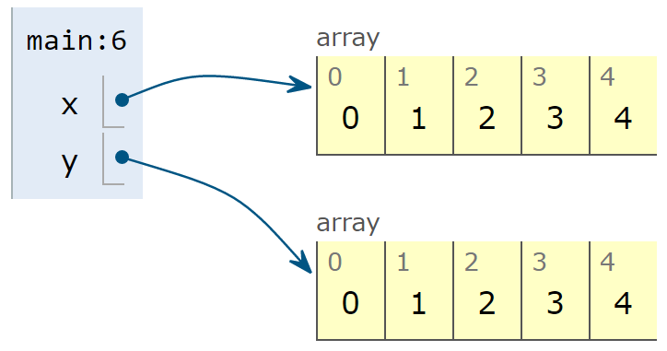
Equals vs. ==
As mentioned in an offhand manner previously, == and .equals() behave differently.
== checks that two variables reference the same object (compares bits in boxes):
To test equality in the sense we usually mean it, use:
Arrays.equal or Arrays.deepEquals for arrays.
.equals for classes. Requires writing a .equals method for your classes.
Default implementation of .equals uses == (probably not what you want).
public static void main(String[] args) {
int[] x = new int[]{0, 1, 2, 3, 4};
int[] y = new int[]{0, 1, 2, 3, 4};
System.out.println(x == y);
}
$ java EqualsDemo
False

Slide 38
Equals Method for Date
Rules for equals() are simple, but implementation is trickier than you might expect.
Webcast viewers: Try it out yourself. See study guide for starter code (Date.java).
public class Date {
private final int month;
private final int day;
private final int year;
public Date(int m, int d, int y) {
month = m; day = d; year = y;
}

Slide 39
Equals Method for Date
public boolean equals(Object x) {
if (this == x) return true;
if (x == null) return false;
if (this.getClass() != x.getClass()) {
return false;
}
Date that = (Date) x;
if (this.day != that.day) {
return false;
}
if (this.month != that.month) {
return false;
}
if (this.year != that.year) {
return false;
}
return true;
}
Rules for equals() are simple, but implementation is trickier than you might expect.
One common approach at right.
public class Date {
private final int month;
private final int day;
private final int year;
public Date(int m, int d, int y) {
month = m; day = d; year = y;
}

Slide 40
Rules for Equals in Java
Java convention is that equals must be an equivalence relation:
Reflexive: x.equals(x) is true.
Symmetric: x.equals(y) is true iff y.equals(x)
Transitive: x.equals(y) and y.equals(z) implies x.equals(z).
Must also:
Take an Object argument.
Be consistent: If x.equals(y), then x must continue to equal y as long as neither changes.
Never true for null, i.e. x.equals(null) must be false.

Slide 41
The Future
There’s plenty of Java we haven’t covered, but this is enough.
We’ll expect you to start finding the syntax and built-in libraries you need, with tips in the HW/Projects for the trickier stuff. Don’t use fancy external libraries like Apache Commons!
Weeks 7-14:
Lectures: Data Structures and Algorithms
Week 7: Project 2: “Advanced Programming”
Weeks 8-14:
Labs: Implement data structures/algorithms.
HWs: Apply data structures algorithms.
Project 3: Efficiency oriented project.
Optional textbook: Algorithms, 4th Edition

Slide 42
Citations
First hit on google images from Exception:
http://education.oge.gov/training/module_files/ogewrkctr_wbt_07/exception.jpg

